Slide 1


Update
Olivier Bergeron
2025-06-16

Slide 2

Trends looked for
Number of electrodes vs electrode size
Number of electrodes vs IED (Inter-electrode distance)
Number of electrodes vs quantity of movement evaluated
All of them were evaluated for a specific classification accuracy (90%)
Major difficulty: only found 5 papers on varying electrode count and accuracy

Slide 3
Trends looked for
Quick conclusions:
Never the same amount of electrodes
Always a smart selection/position of electrodes
No paper got the same maximum classification accuracy
Some papers put electrodes on the hand
Trends appear when taking in count percentage of electrode instead of absolute number of electrodes and classification accuracy relative to its max

Slide 4
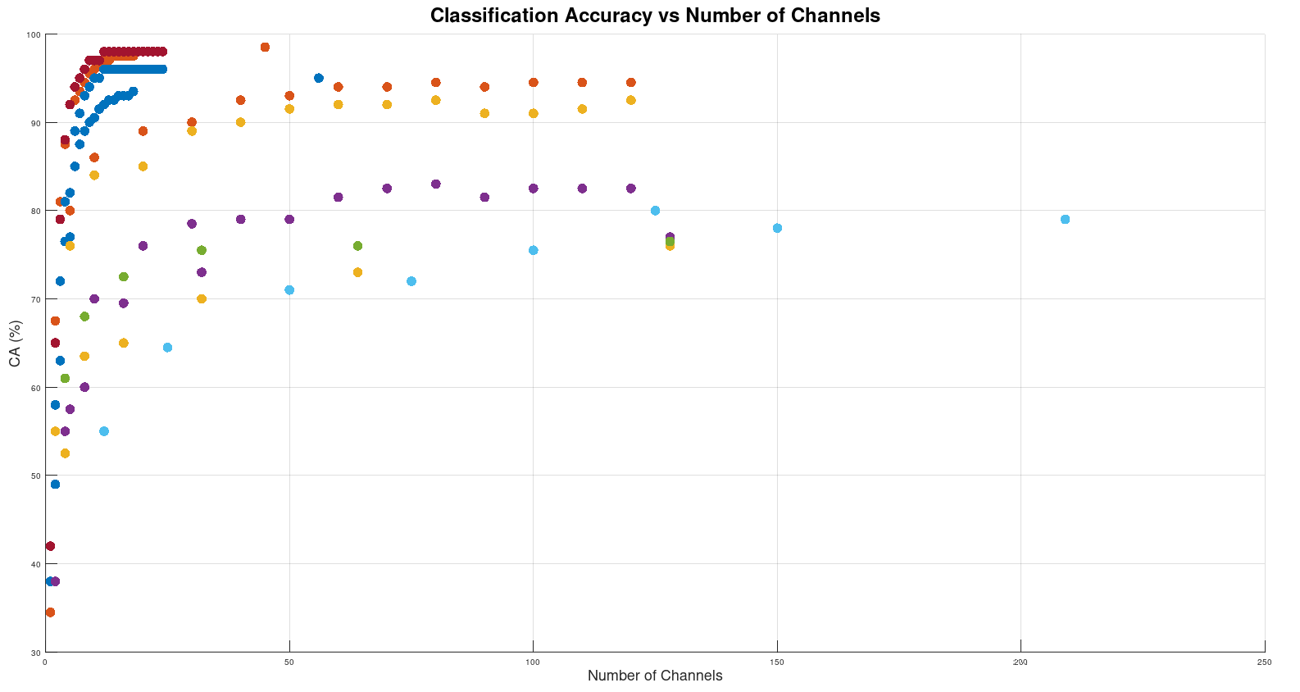

Slide 5
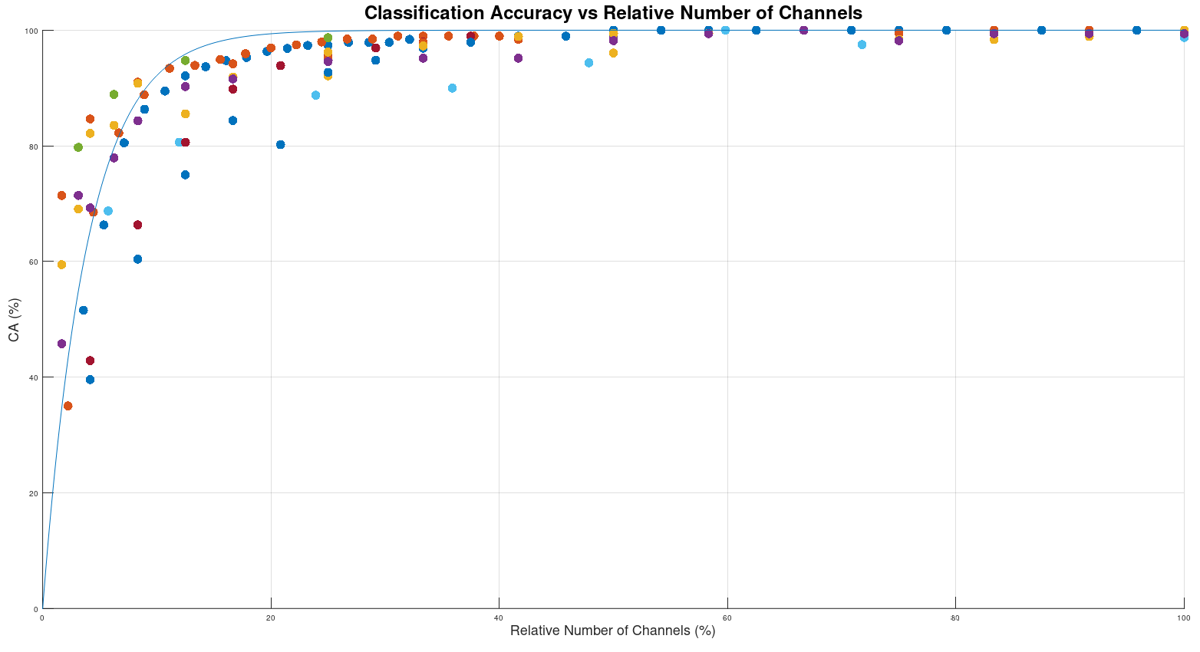

Slide 6
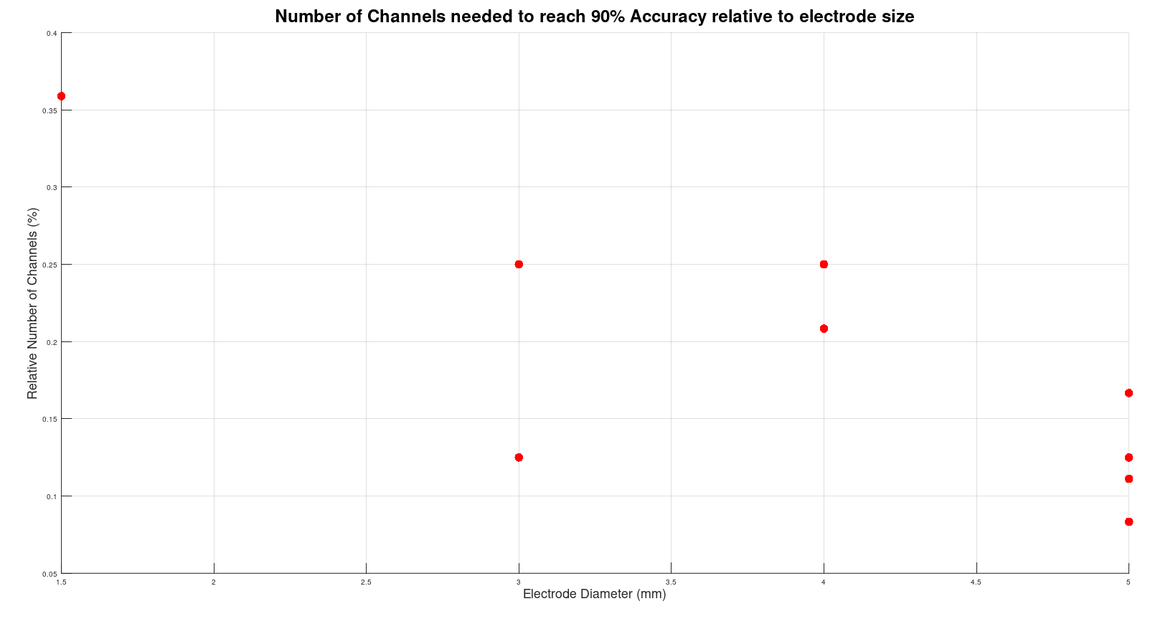
Logic trend: smaller electrodes -> lower signal amplitude -> need more electrodes

Slide 7
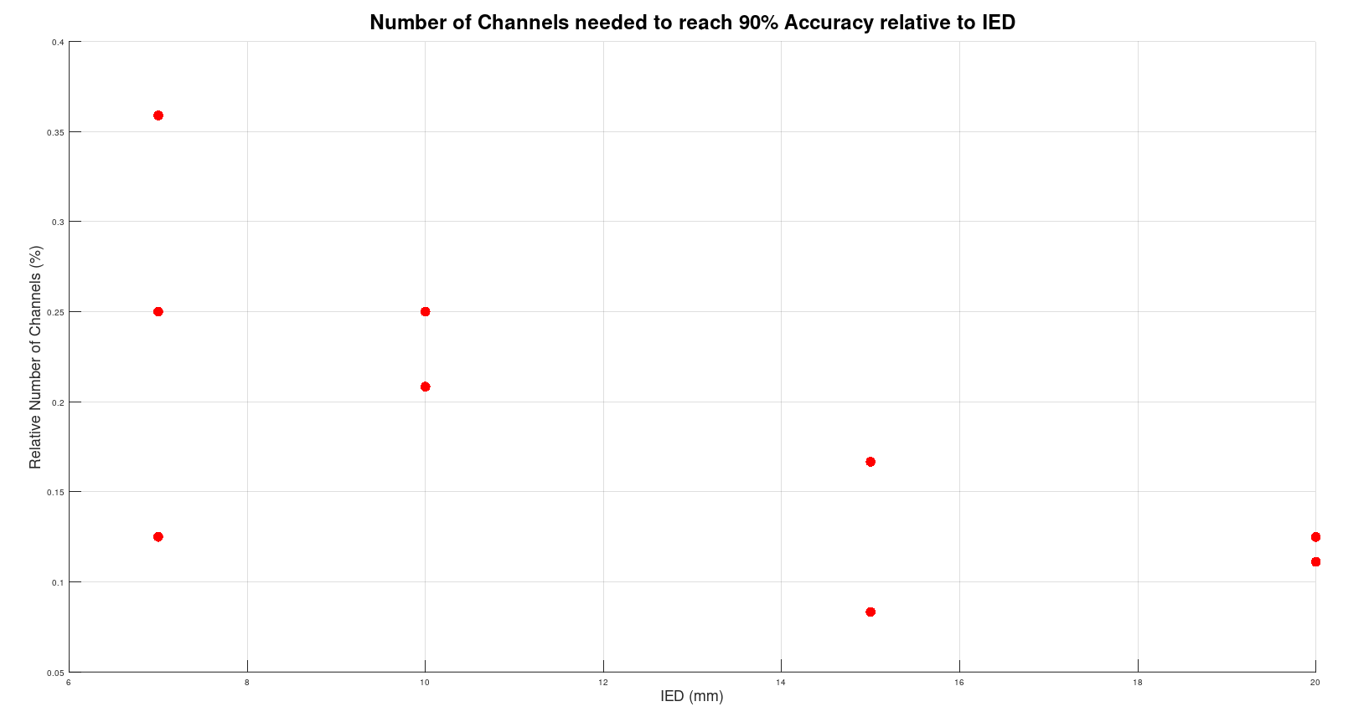
Logic trend: closer electrodes -> smaller electrodes -> lower signal amplitude -> need more electrodes

Slide 8
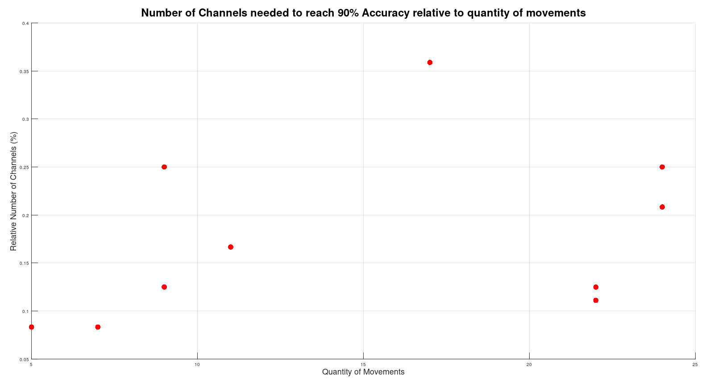
Trend seems to look like more movements requires a little more electrodes

Slide 9
Next trend to look for
Number of detectable motor units vs number of electrodes
As of right now: only found 1 paper
A. H. Caillet et al., « Larger and Denser: An Optimal Design for Surface Grids of EMG Electrodes to Identify Greater and More Representative Samples of Motor Units », eNeuro, vol. 10, nº 9, p. ENEURO.0064-23.2023, sept. 2023, doi: 10.1523/ENEURO.0064-23.2023.

Slide 10
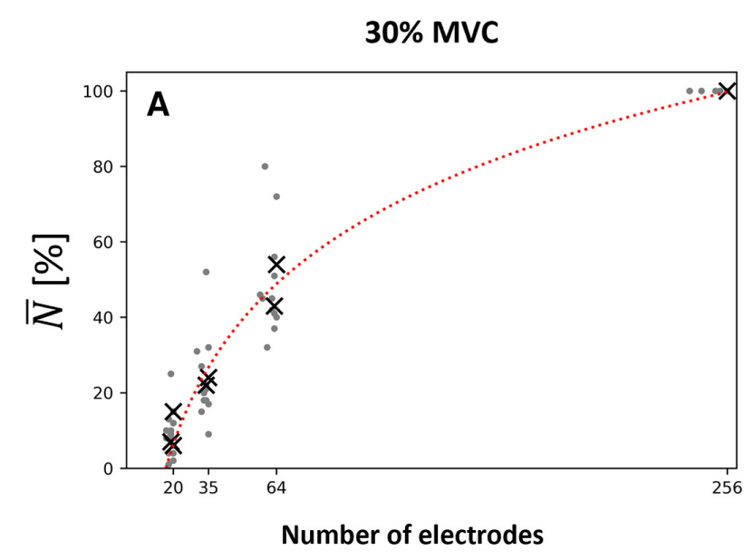

Slide 11
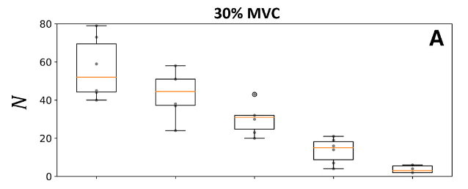
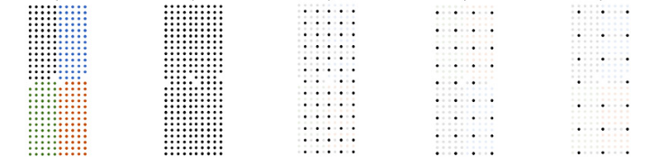

Slide 12
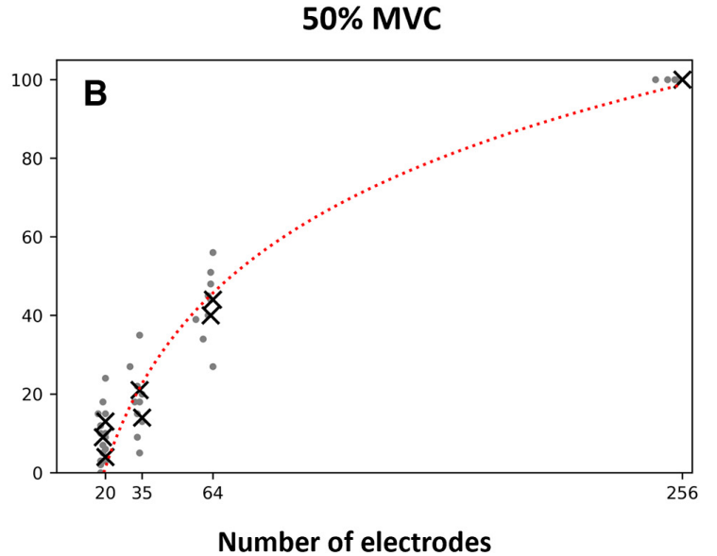


Slide 13
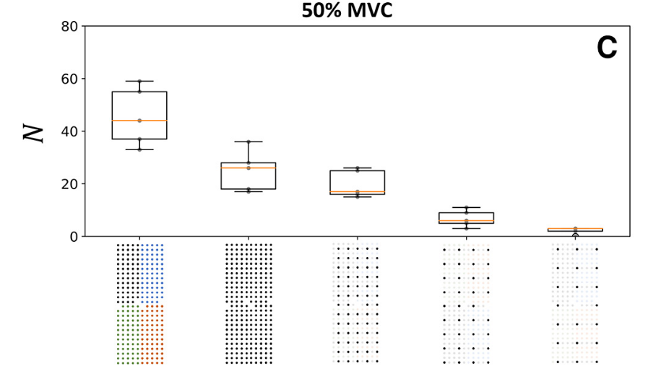

Slide 14
Partial conclusions
Going denser:
Tends to give a little more accuracy
Seems to give more detectable motor units

Slide 15
Next steps
Keep trying to find papers on motor unit detection vs quantity of electrodes

